Slide 1
Chapter 16
User Interface Design
Notes:
This repository of slides is intended to support the named chapter. The slide repository should be used as follows:
Copy the file to a unique name for your course and unit.
Edit the file by deleting those slides you don’t want to cover, editing other slides as appropriate to your course, and adding slides as desired.
Print the slides to produce transparency masters or print directly to film or present the slides using a computer image projector.
Each slide includes instructor notes. To view those notes in PowerPoint, click-left on the View Menu; then click left on Notes View sub-menu. You may need to scroll down to see the instructor notes.
Teaching Notes
The emphasis of this chapter is with the physical design phase, focusing on COMMUNICATION. It involves system designers and systems analysts.

Slide 2
Objectives
Distinguish between different types of computer users and design considerations for each.
Identify several important human engineering factors and guidelines and incorporate them into a design of a user interface.
Integrate output and input design into an overall user interface that establishes the dialogue between users and computer.
Understand role of operating systems, web browsers, and other technologies for user interface design.
Apply appropriate user interface strategies to an information system. Use a state transition diagram to plan and coordinate a user interface.
Describe how prototyping can be used to design a user interface.
Notes:
No additional notes.

Slide 3
System User Classifications
Expert User – an experienced computer user
Spends considerable time using specific application programs.
Use of a computer is usually considered non-discretionary.
In the mainframe computing era, this was called a dedicated user.
Novice User – a less experienced computer user
Uses computer on a less frequent, or even occasional, basis.
Use of a computer may be viewed as discretionary (although this is becoming less and less true).
Sometimes called a casual user.
Notes:
Teaching Notes
Emphasize that expert and novice users are actually extremes in the continuum of all users. The totally novice user who hasn’t used a computer is becoming less common.
Mention some people that the students might know (perhaps a department secretary, yourself, another colleague, etc.) and ask the students to characterize them as an expert or novice user. Be sure to acknowledge, once again, that some individuals may fit in between the two extremes.
A given user might be an expert at PowerPoint, a novice at PhotoShop, and something in between at Excel.

Slide 4
Interface Problems
According to Galitz, the following problems result in confusion, panic, frustration, boredom, misuse, abandonment, and other undesirable consequences.
Excessive use of computer jargon and acronyms
Imperceptible or less-than-intuitive design
Inability to distinguish between alternative actions (“what do I do next?”)
Inconsistent problem-solving approaches
Design inconsistency
Notes:
Teaching Notes
The above points can be driven home by providing the students with some sample screen designs that exhibit the various problems.

Slide 5
Commandments of User Interface Design
Understand your users and their tasks.
Involve the user in interface design.
Test the system on actual users.
Practice iterative design.
Notes:
Teaching Notes
These also come from Galitz.

Slide 6
Human Engineering Guidelines
The user should always be aware of what to do next
Tell user what the system expects right now.
Tell user that data has been entered correctly.
Tell user that data has not been entered correctly.
Explain reason for a delay in processing.
Tell user a task was completed or not completed.
Format screen so instructions and messages always appear in same general display area.
Display messages and instructions long enough so user can read them.
Notes:
Teaching Tips
The above points can be driven home by providing the students with some sample screen designs that exhibit a failure to take into consideration the above guidelines.
Alternatively, obtain some screen shots of a sample application from a local company and have the students assess the screens relative to the above guidelines.

Slide 7
Human Engineering Guidelines (continued)
Use display attributes carefully.
Default values should be specified.
Anticipate errors users might make.
Users should not be allowed to proceed without correcting an error.
If user does something that could be catastrophic, the keyboard should be locked to prevent any further input, and an instruction to call the analyst or technical support should be displayed.
Notes:
Teaching Notes
Entire books have been written on the subject of user interface design. Feel free to add additional user interface design considerations you want to bring to the students attention (such as the user of color, consideration of handicapped individuals, etc.). We provided several references to books on the subject of user interface design.

Slide 8
Guidelines for dialogue Tone and Terminology
Dialogue – the overall flow of screens and messages for an application
Tone:
Use simple, grammatically correct sentences.
Don’t be funny or cute!
Don’t be condescending.
Terminology
Don’t use computer jargon.
Avoid most abbreviations.
Use simple terms.
Be consistent in your use of terminology.
Carefully phrase instructions—use appropriate action verbs.
Notes:
Teaching Notes
The above points can be driven home by providing the students with some sample screen designs that exhibit the incorrect use of tone and terminology.
Have the students give examples of instructions that might appear on a screen. Is the tone and terminology acceptable?

Slide 9
User Interface Technology
Operating Systems and Web Browsers
GUI
Windows, Macintosh, UNIX, Linux, Palm OS, Windows CE
Growing importance of platform independence
Display Monitor
Regular PC monitors
Non-GUI terminals
Growing importance of devices such as handhelds
Paging – Display complete screen of characters at a time.
Scrolling – Display information up or down a screen one line at a time.
Keyboards and Pointers
Mouse
Pens
Notes:
Teaching Notes
The manner in which the display area is shown to the user is controlled by both the technical capabilities of the display and the operating system capabilities. Paging and scrolling are the two most common approaches to showing the display area to the user.
Scrolling is often used in web sites where a web page can be infinitely long. However users can get lost if they have to scroll too much to enter their inputs. In those cases, paging gives more control both to the user and the programmer.

Slide 10
Graphical User Interfaces Styles and Considerations
Windows and frames
Menu-driven interfaces
Pull-down and cascading menus
Tear-off and pop-up menus
Toolbar and iconic menus
Hypertext and hyperlink menus
Instruction-driven interfaces
Language-based syntax
Mnemonic syntax
Natural language syntax
Question-answer dialogue
Notes:
Teaching Notes
These will be illustrated in the following slides.
Consider using a laptop and projection capability to demonstrate a software product(s) or application and its use of the different types of GUI menus.
Emphasize to the students that the above styles/strategies should not be viewed as alternatives.

Slide 11
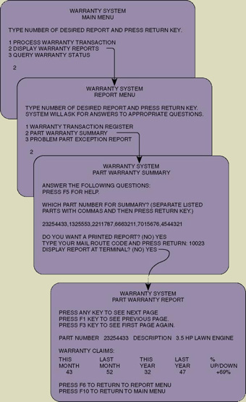
A Classical Hierarchical Menu Dialogue
Notes:
No additional notes.

Slide 12
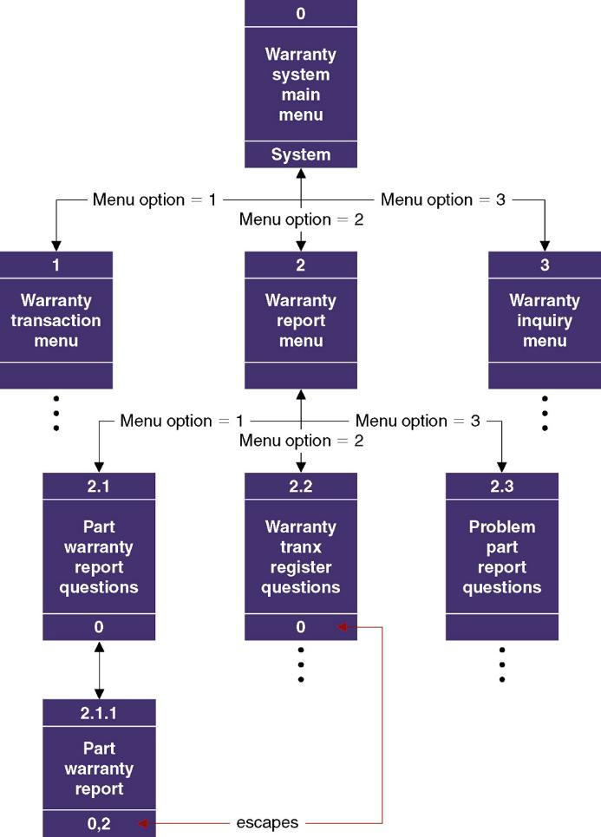
Sample Dialogue Chart
Notes:
Teaching Notes
This chart was created by the authors as a tool for designing dialogues for on-line mainframe-based computing solutions. Subsequently, the tool has been adopted and adapted by numerous authors of systems development textbooks.
The authors emphasize that this tool has become ineffective in design GUI screens because today’s GUI design solutions are not naturally hierarchical.

Slide 13
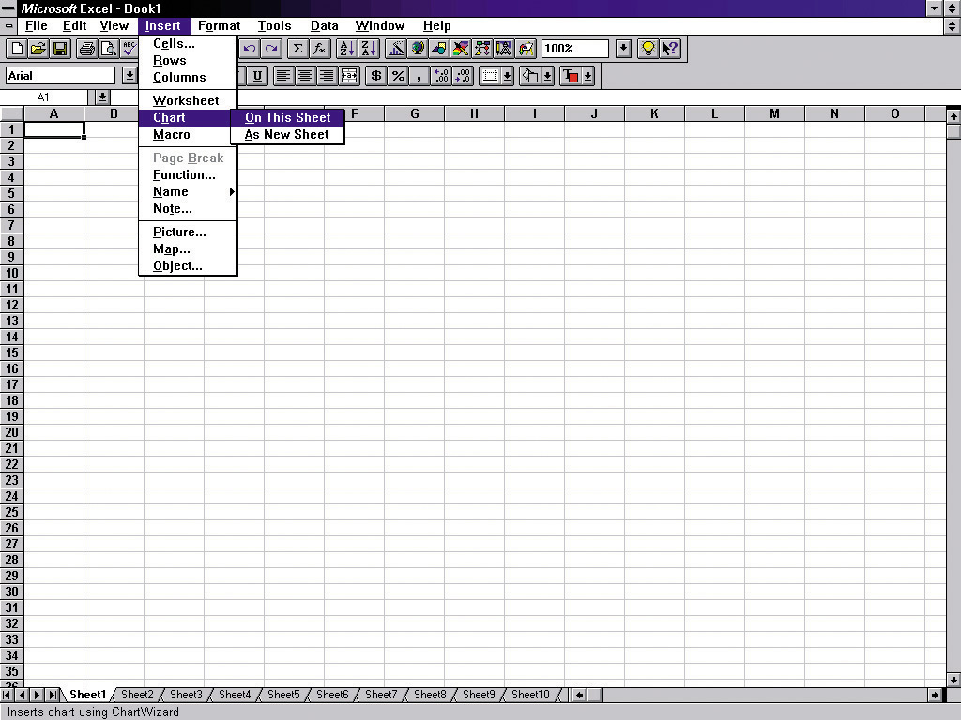
Pull-Down and Cascading Menus
menu bar
Cascading menu
Ellipses indicates dialogue box
Pull-down menu
Notes:
No additional notes.

Slide 14
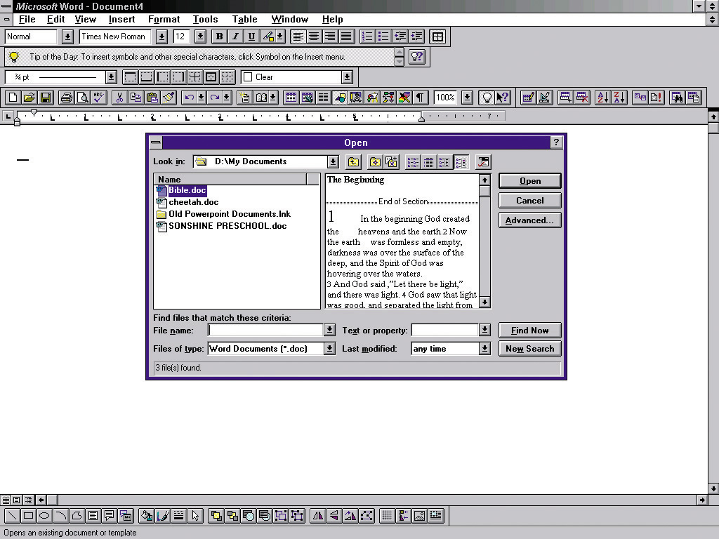
Dialogue Box
Notes:
No additional notes.

Slide 15
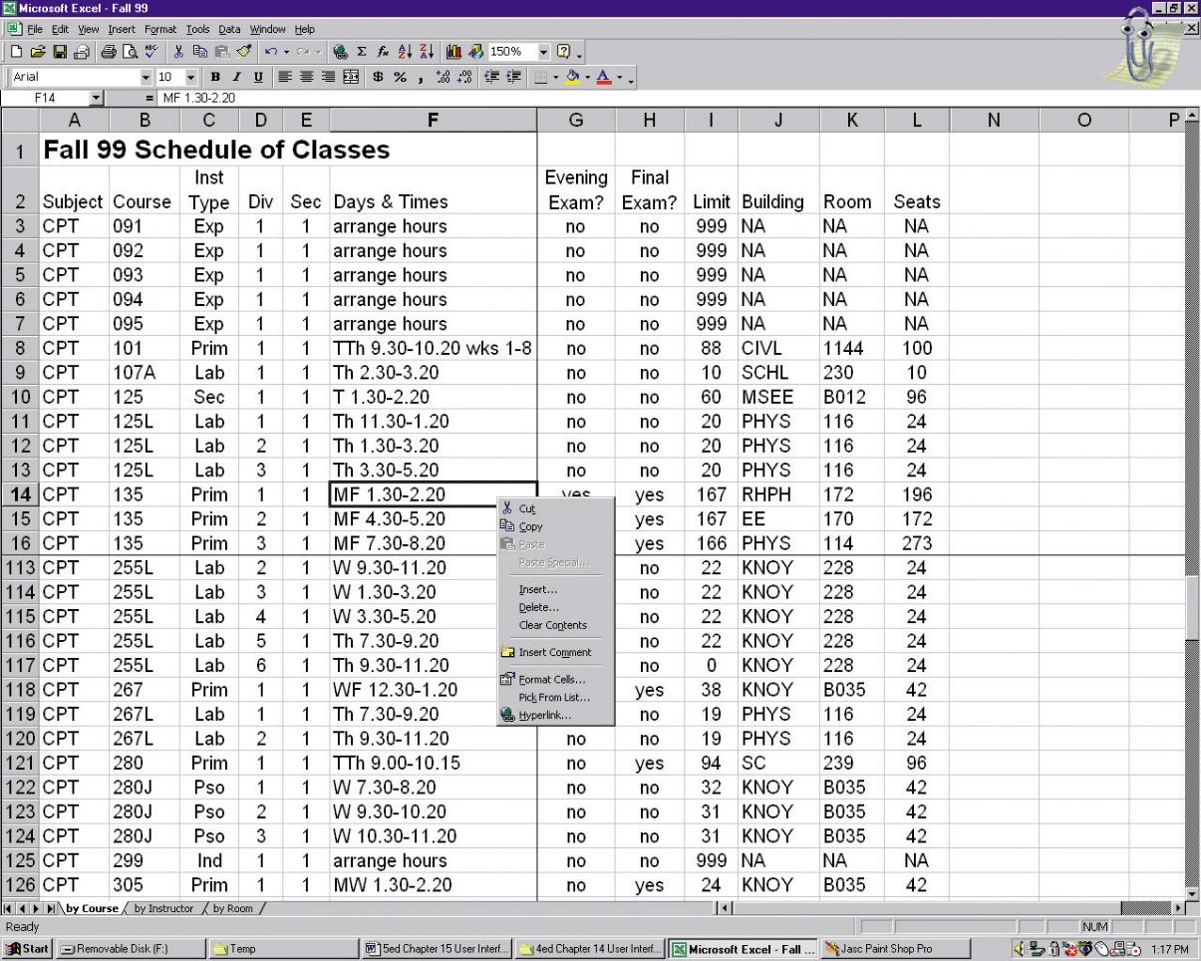
Pop-Up Menus
Notes:
Teaching Notes:
Be sure to emphasize that such menus are not as appropriate for the novice user because they are less likely to even know the menu exists (since there is no visual hint of its existence).

Slide 16
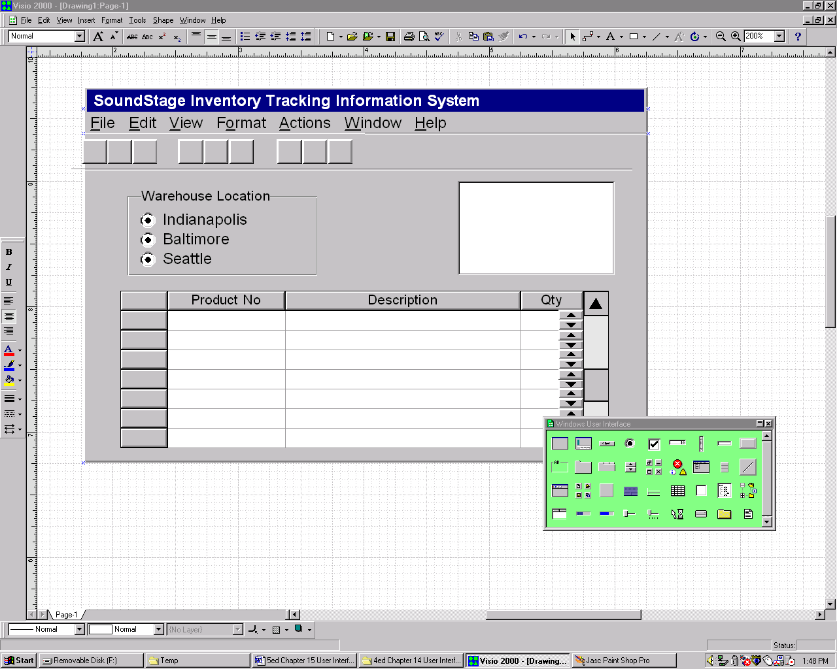
Tool Bars
Notes:
No additional notes.

Slide 17
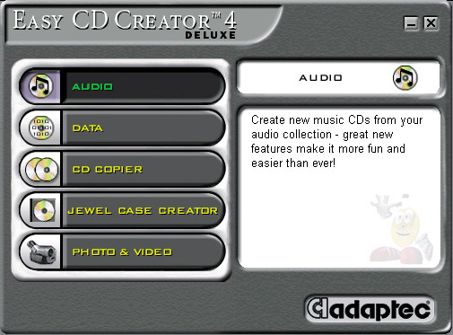
Iconic Menus
Notes:
No additional notes.

Slide 18
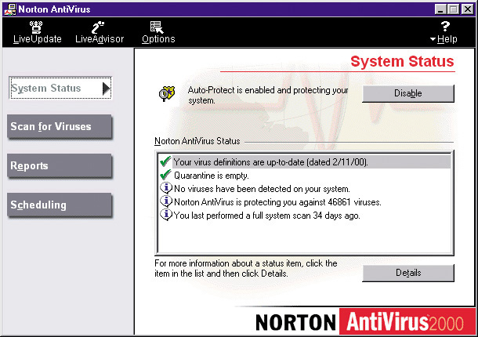
Consumer-Style Interface
Notes:
Teaching Notes
Consumer-style interfaces are somewhat more artistic
The primary look and feel is more web-like
The interface consists of clickable icons and buttons that replace more traditional Windows menu approaches

Slide 19
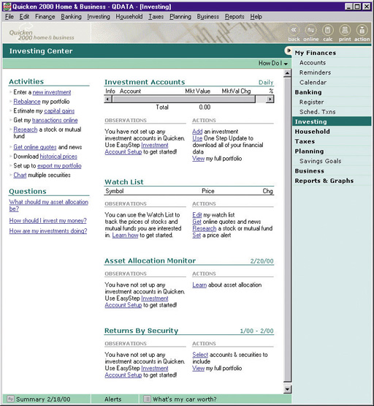
Hybrid Windows/Web Interface
Notes:
No additional notes.

Slide 20
Instruction-Driven Interfaces
Language-based syntax is built around a widely accepted command language that can be used to invoke actions
SQL
Mnemonic syntax is built around commands defined for custom information systems.
Commands unique to that system and meaningful to user
Natural language syntax allows users to enter questions and command in their native language
Notes:
No additional notes.

Slide 21
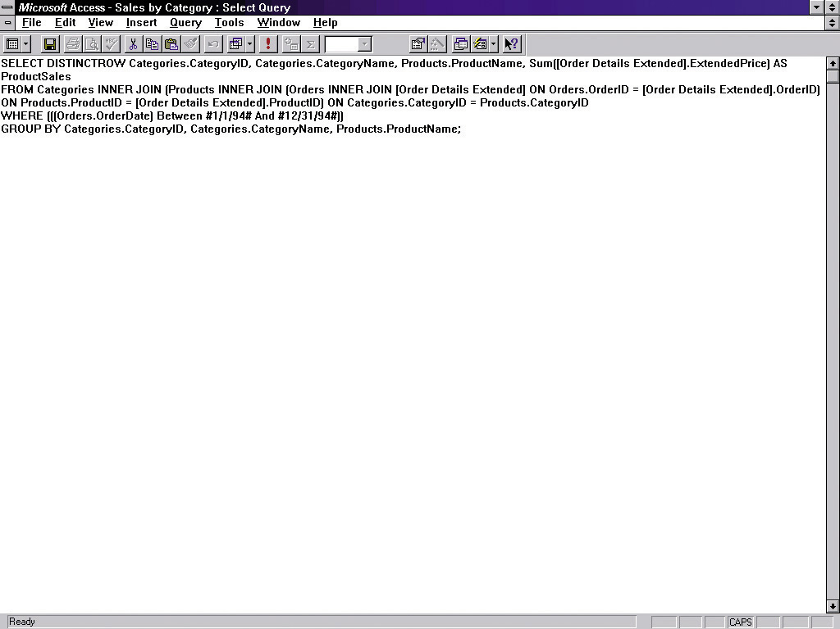
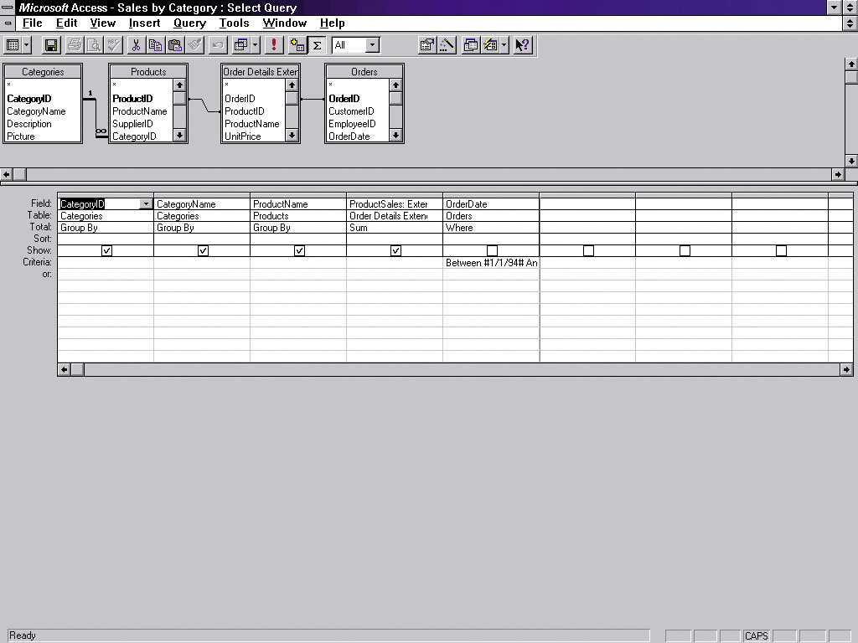
Instruction-Driven Interface
Notes:
No additional notes.

Slide 22
Special Considerations for User Interface Design
Internal Controls – Authentication and Authorization
User ID and Password
Privileges assigned to roles
Web certificates
Online Help
Growing use of HTML for help systems
Help authoring packages
Tool tips
Help wizards
Agents – reusable software object that can operate across different applications and networks.
Notes:
Teaching Notes
Screens to illustrate these concepts are on the following slides

Slide 23
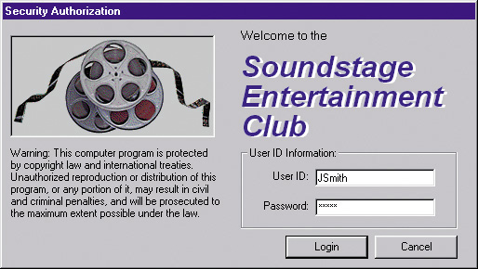
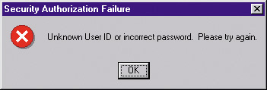
Authentication Log-in Screen and Error Screen
Notes:
No additional notes.

Slide 24
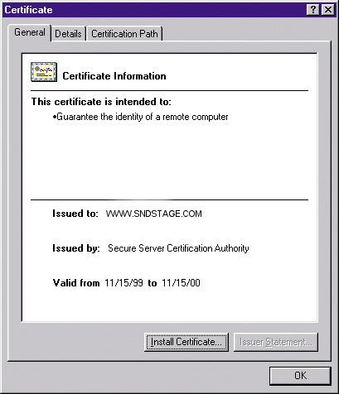
Server Security Certificate
Notes:
No additional notes.

Slide 25
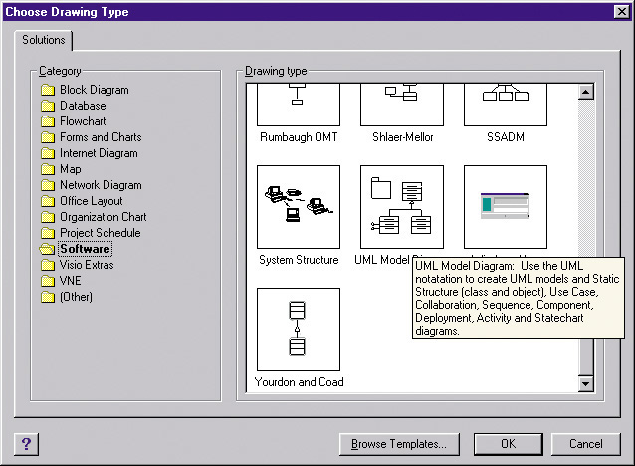

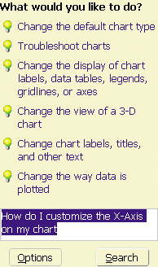
Help Tool Tip, Help Agent, and Natural Language Processing
Notes:
No additional notes.

Slide 26
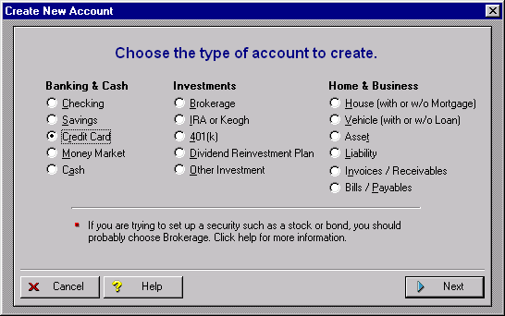
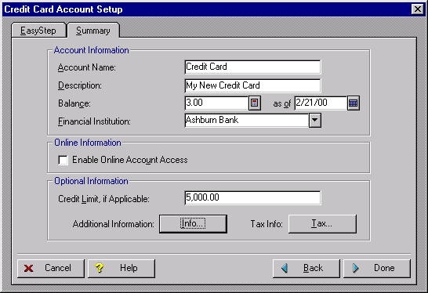
Help Wizard
Notes:
No additional notes.

Slide 27
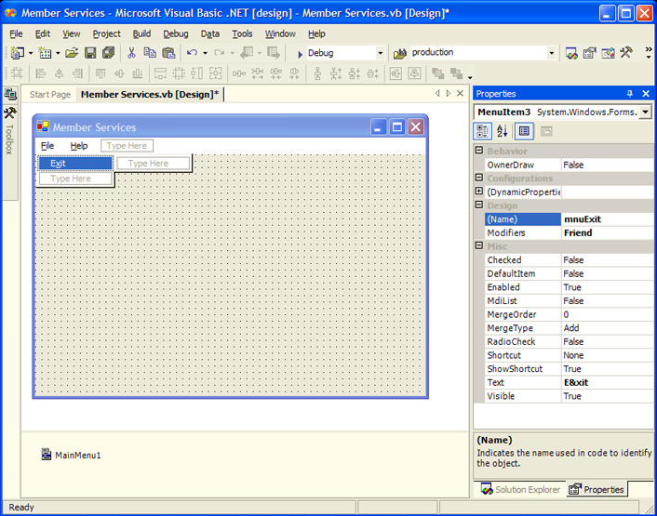
Automated Tools for User Interface Design & Prototyping
Microsoft Access
CASE Tools
Visual Studio
Excel
Visio
Visual Studio .NET Menu Construction
Notes:
No additional notes.

Slide 28
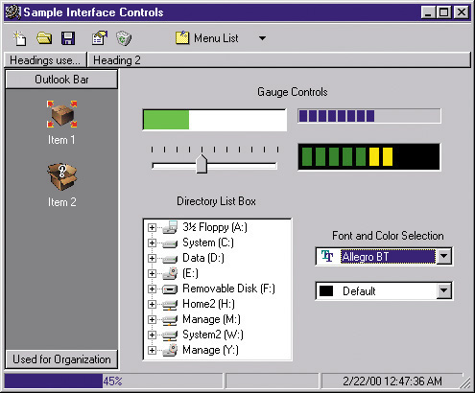
Additional User Interface Controls in Visual Basic
Notes:
Teaching Notes:
Feel free to provide additional screen shots of other user interface controls not presented in the textbook. These are only a few of the many controls that continue to evolve.

Slide 29
The User Interface Design Process
Chart the user interface dialogue.
State Transition Diagram– a tool used to depict the sequence and variation of screens that can occur during a user session.
Prototype the dialogue and user interface.
Obtain user feedback.
Exercising (or testing) the user interface
If necessary return to step 1 or 2
Notes:
Teaching Notes
In practice these steps are not strictly sequential.

Slide 30
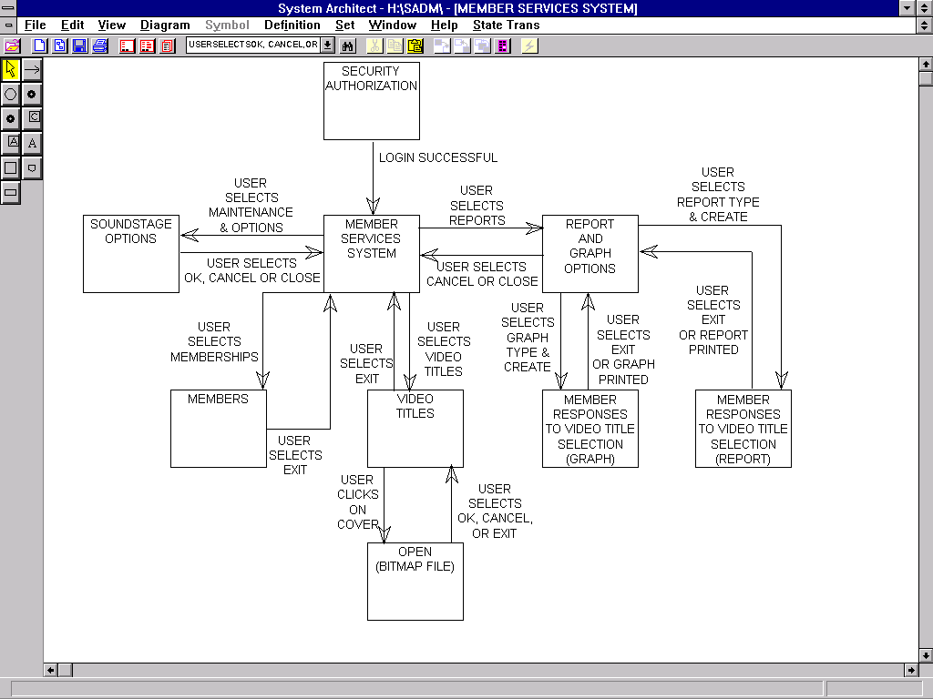
SoundStage Partial State Transition Diagram
Notes:
No additional notes.

Slide 31
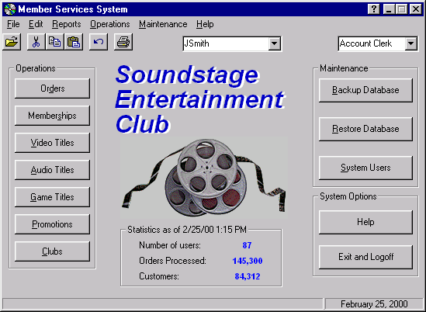
SoundStage Main Menu
Notes:
No additional notes.

Slide 32
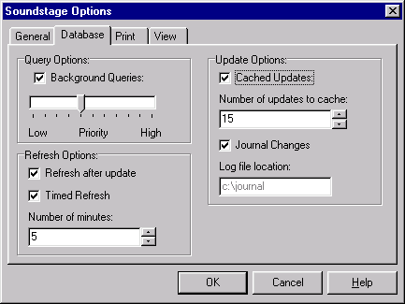
SoundStage Options and Preferences Screen
Notes:
No additional notes.

Slide 33
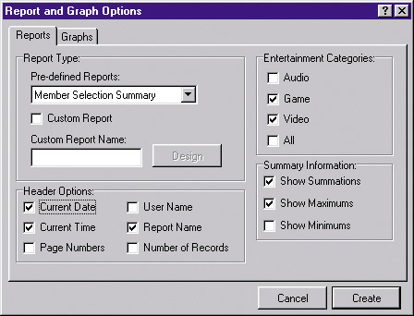
SoundStage Report Customization dialogue Screen
Notes:
No additional notes.

Slide 34
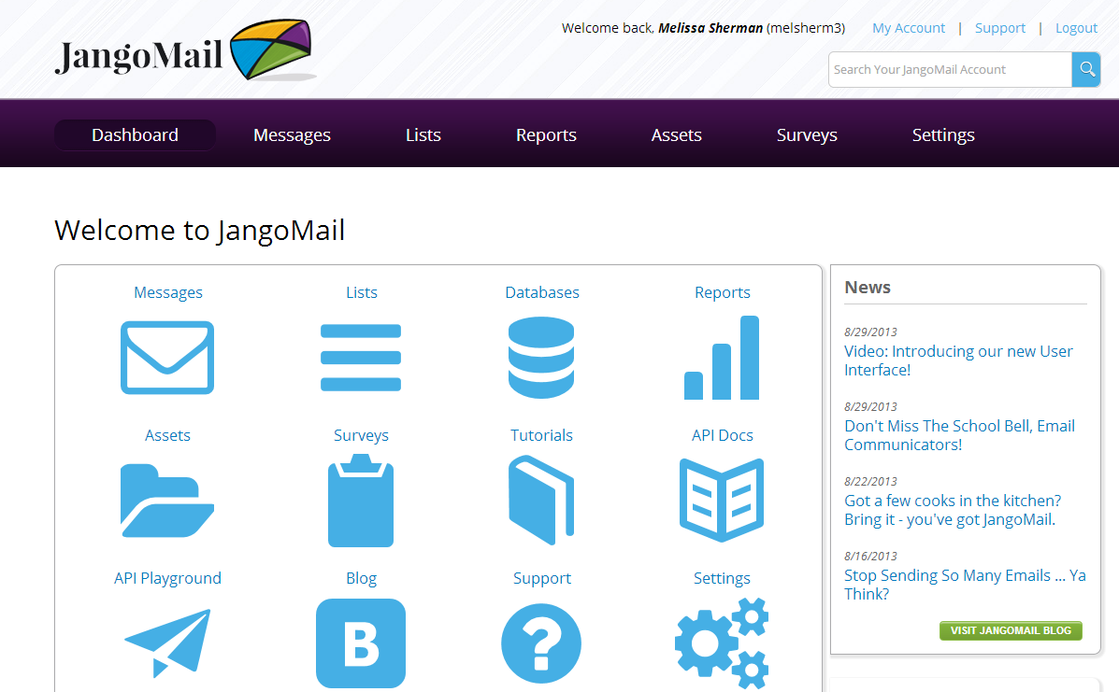

Slide 35
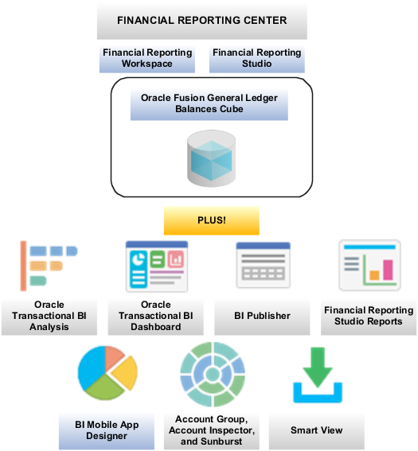

Slide 36
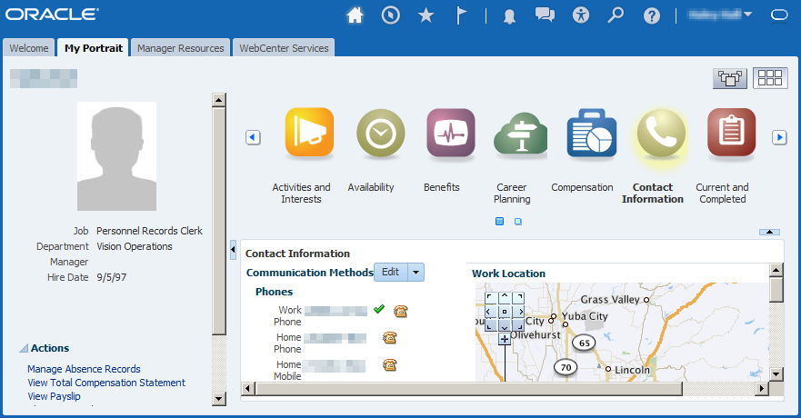

Slide 37
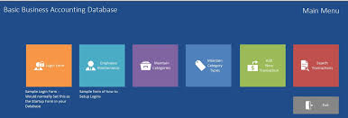
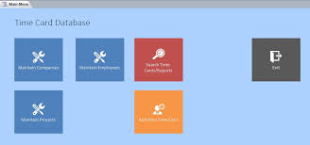

Slide 38
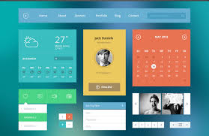

Slide 39
